Slide 1
Tehnici Web
Ioana Leustean
Sem.II, 2016

Slide 2

Internet si WWW

Slide 3
INTERNET = "interconnection of computer networks”
sistem de retele de calculatoare interconectate
care folosesc protocolul TCP/IP
PROTOCOL (specificatie tehnica) = o multime de reguli si conventii faciliteaza si controleaza schimbul
de date intre dispozitive diferite
TCP/IP = stabileste si controleaza transmisia datelor
Componente (servicii): FTP, TELNET, EMAIL,
CHAT, WWW, …
Orice echipament conectat la Internet este identificat prin adresa IP (eticheta numerica)

Slide 4
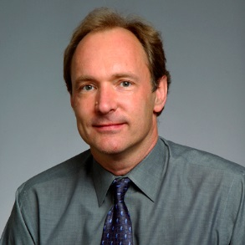
HYPERTEXT = text (afisat pe un dispozitiv electronic) care contine referinte (“hyperlink”) la date ce pot fi accesate imediat.
WWW = un sistem de documente hypertext interconectate, care poate fi accesat in Internet (creat de Tim Berners-Lee)
“The Web is an abstract (imaginary) space of
information. On the Net, you find computers –
on the Web, you find document, sounds, videos,....
information. On the Net, the connections are cables
between computers; on the Web, connections are
hypertext links.”
http://www.w3.org/People/Berners-Lee/FAQ.html#InternetWeb
Tim Berners-Lee
Weaving the Web
World Wide Web Consortium (W3C)
World Wide Web Foundation

Slide 5
WWW - tehnologii fundamentale:
HTML = Hypertext Markup Language
limbajul in care se scriu documentele pe Web
URI = Uniform Resource Identifier
un identificator unic pentru fiecare resursa din Web
HTTP = HyperText Transfer Protocol
stabileste regulile de comunicare pe Web
SERVER = program care ruleaza pe un calculator conectat la Internet si care furnizeaza resurse Web
BROWSER = programe care faciliteaza accesul la
resursele web

Slide 6
URI = sir de caractere care identifica o resursa prin nume sau locatie
URN = Uniform Resource Name
(identificare prin nume)
URN: ISBN: 9780062515872
URL = Uniform Resource Locator
(identificare prin locatie)
http://www.w3.org/Protocols/rfc2616/rfc2616-sec3.html

Slide 7
URL
protocol:// host:port /location?query#fragment
HTTP (port 80)
http://webdesign.about.com/
http://search.about.com/?q=URL
HTTPS = HTTP + securitate (port 443)
https://sites.google.com/site/igleustean/public#JIssues
File URL = legatura la un fisier local
file:///C:/Users/Leustean/Desktop/ex.html
file:///C:/Users/Leustean/Desktop/ex.html?numele=Ioana#jos

Slide 8
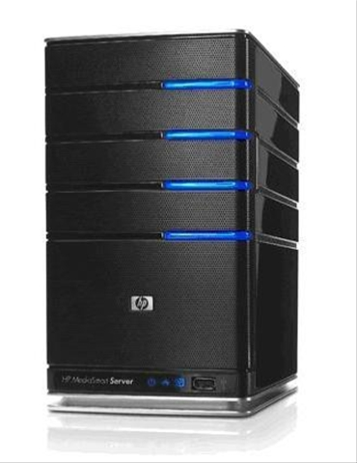
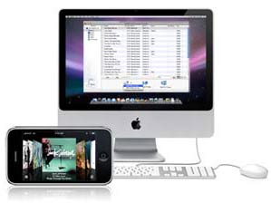
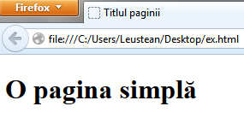
Client Server
Cerere(Request)
HTTP
Raspuns (Response)
BROWSER
Metoda
GET http://...../ex.html
1
ex.html OK
2
BROWSER
Status
3

Slide 9
Front-end
Partea care interactioneaza cu utitlizatorul
Este controlata de browser
Tehnologii:
HTML, CSS, JavaScript, framework-uri
Back-end
Are trei componente:
serverul, aplicatia si baza de date
Tehnologii: PHP, Ruby, .NET, Node.js,…
"A front-end dev. is responsible for the interior design of a house that’s been built by a back-end dev."
http://blog.udacity.com/2014/12/front-end-vs-back-end-vs-full-stack-web-developers.html

Slide 10

HTML5
CSS3
JavaScript
jQuery
RWD
Ajax
XML JSON
Sursa imaginii

Slide 11


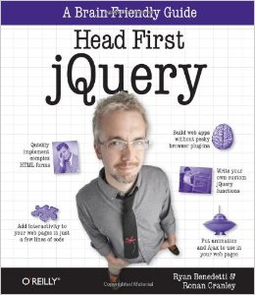
Bibliografie:
Resurse online: W3C, MDN
Curs/Laborator:
moodle
https://sites.google.com/site/igleustean/teaching
https://labtehniciweb.wordpress.com/
jsbin

Slide 12

Istoria
SGML= Standardised Generalised Markup Language
Charles Goldfarb, Ed Mosher, Ray Lorie, 1970, IBM
HTML = HyperText Markup Language
Tim Berners-Lee, 1989, CERN
World Wide Web Consortium W3C ,1994
XML = Extensible Markup Language http://www.w3.org/standards/xml/ , 1996
HTML4 (1997), XHTML (2000)
versiunea recomandata de W3C incepand cu 2012
Limbaje folosite
pentru a specifica
limbaje de marcare

Slide 13
<!DOCTYPE html> <html> <!-- ex-div-dpan-css.html -->
<head>
<title>div si span</title>
</head>
<body> <section>
<p> Paragraf normal cu text normal.</p>
<div id=“gpdep">
<p> Paragraf deplasat cu text normal.</p>
<p> Paragraf deplasat cu <span class="rosu"> text rosu. </span></p>
</div>
<p> Paragraf normal cu <span class="rosu"> text rosu. </span>
</p>
</section></body></html>
<style type=“text/css”>
body {background-color:#737373;}
p {margin-left:5px;}
section {width:80%; background-color:white;}
#gpdep {margin-left:15px;}
.rosu {color:red;}
</style>
CSS
Cascade Style Sheet

Slide 14
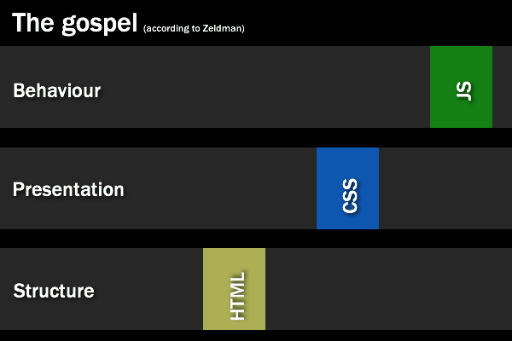
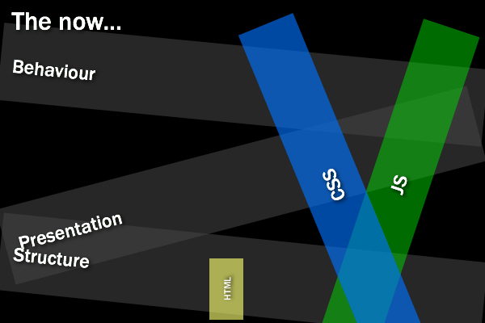
C. Heilmann – We need New Best Practices for a Different Development World
Stil CSS in fisier separat
<link href=“mystyle.css" type=“text/css” rel=“stylesheet">
Codul JavaScript in fisier separat
<script type="text/javascript" src=“NumeFisier.js"></script>

Slide 15
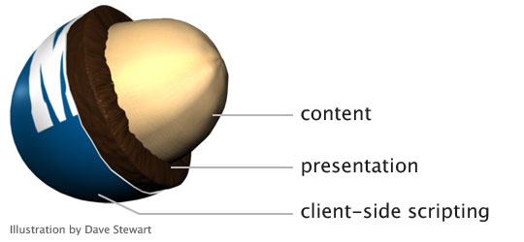
“Start with your content peanut, marked up in rich, semantic (X)HTML.
Coat that content with a layer of rich, creamy CSS.
Finally, add JavaScript as the hard candy shell to make a wonderfully
tasty treat (and keep it from melting in your hands).”
“Understanding progressive enhancement”, Aaron Gustafson, A List Apart

